Slide 1
Outlier analysis
Vijayalakshmi Anand

Slide 2
Outlier Analysis
Source Courtesy: Some of the contents of this PPT are sourced from materials provided by publishers of prescribed books

Slide 3
Statistical Outliers

Slide 4
Statistical Approaches
Statistical approaches assume that the objects in a data set are generated by a stochastic process (a generative model)
The effectiveness of statistical methods highly depends on whether the assumptions made for the statistical model hold true for the given data
Statistic models used in the methods may be parametric or nonparametric.
A parametric method assumes that the normal data objects are generated by a parametric distribution
A nonparametric method does not assume a priori statistical model. Instead, a nonparametric method tries to determine the model from the input data.

Slide 5
Discordancy test
The statistical distribution-based approach identifies outliers with respect to the model using a discordancy test.
A statistical discordancy test examines first a working hypothesis. A working hypothesis, H, is a statement that the entire data set of n objects comes from an initial distribution model, F, that is,
H : o_{i} ϵ F, where i=1,2,….n
The hypothesis is retained if there is no statistically significant evidence supporting its rejection
A discordancy test verifies whether an object, o_{i}, is significantly large (or small) in relation to the distribution F
The result is very much dependent on which model F is chosen because o_{i} may be an outlier under one model and a perfectly valid value under another.

Slide 6
Alternative distributions
Inherent alternative distribution: In this case, the working hypothesis that all of the objects come from distribution F is rejected in favor of the alternative hypothesis that all of the objects arise from another distribution, G:
H_{a} : o_{i} ϵ G, where i=1,2,….n
F and G may be different distributions or differ only in parameters of the same distribution. For example, it may have a different mean or dispersion, or a longer tail.

Slide 7
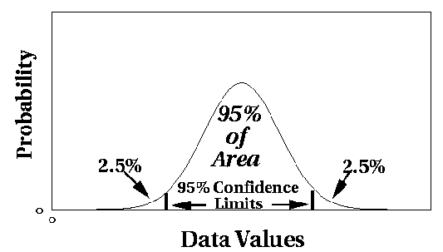
Statistical Approaches – Parametric Methods
Assumes that the normal data is generated by a parametric distribution with parameter θ
The probability density function of the parametric distribution f(x, θ) gives the probability that object x is generated by the distribution
The smaller this value, the more likely x is an outlier
The parametric distribution can be normal distribution with a mean and variance.
Outliers are points where probability of occurrence is below a threshold.

Slide 8


Parametric Methods: Univariate Outliers
Univariate data: A data set involving only one attribute or variable
Often assume that data are generated from a normal distribution, learn the parameters from the input data, and identify the points with low probability as outliers
Ex: Avg. temp.: {24.0, 28.9, 28.9, 29.0, 29.1, 29.1, 29.2, 29.2, 29.3, 29.4}
Use the maximum likelihood method to estimate μ and σ

Slide 9
Parametric Methods: Univariate Outliers
Avg. temp.: {24.0, 28.9, 28.9, 29.0, 29.1, 29.1, 29.2, 29.2, 29.3, 29.4}
For the above data with n = 10, we have
Then (24 – 28.61) /1.51 = – 3.04 < –3, 24 is an outlier since

Slide 10
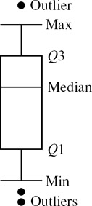
Visual Approach
A straightforward method for statistical outlier detection can also be used in visualization, e.g., the boxplot method plots the univariate input data using a five-number summary
the smallest nonoutlier value (Min),
the lower quartile (Q1),
the median (Q2),
the upper quartile (Q3), and
the largest nonoutlier value (Max).
The interquantile range (IQR) is defined as Q3 − Q1. Any object that is more than 1.5 × IQR smaller than Q1 or 1.5 × IQR larger than Q3 is treated as an outlier because the region between Q1 − 1.5 × IQR and Q3 + 1.5 × IQR contains 99.3% of the objects. The rationale is similar to using 3σ as the threshold for normal distribution

Slide 11

Parametric Methods: Detection of Multivariate Outliers
Multivariate data: A data set involving two or more attributes or variables
Transform the multivariate outlier detection task into a univariate outlier detection problem
Method 1. Compute Mahalanobis distance
Mahalanobis distance is a measure of the distance between a point P and a distribution D.
This distance is zero if P is at the mean of D, and grows as P moves away from the mean: along each principal component axis, it measures the number of standard deviations from P to the mean of D
Method 2. Use χ² –statistic:
where E_{i} is the mean of the i-dimension among all objects, and n is the dimensionality
If χ² –statistic is large, then object o_{i} is an outlier
11

Slide 12
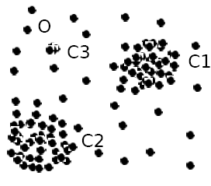
Parametric Methods: Using Mixture of Parametric Distributions
Assuming data generated by a normal distribution could be sometimes overly simplified
To overcome this problem, assume the normal data is generated by two normal distributions. For any object o in the data set, the probability that o is generated by the mixture of the two distributions is given by
where f_{θ1} and f_{θ2} are the probability density functions of θ₁ and θ₂
Then use EM algorithm to learn the parameters μ₁, σ₁, μ₂, σ₂ from data
An object o is an outlier if it does not belong to any cluster
12

Slide 13
Detecting outliers
There are two basic types of procedures for detecting outliers:
Block procedures
Consecutive (or sequential) procedures

Slide 14
Non-Parametric Methods: Detection Using Histogram
The model of normal data is learned from the input data without any a priori structure.
Outlier detection using histogram:
Problem: Hard to choose an appropriate bin size for histogram
Too small bin size → normal objects in empty/rare bins, false positive
Too big bin size → outliers in some frequent bins, false negative
14

Slide 15
Proximity Based Outliers

Slide 16
Proximity-Based Approaches: Distance-Based vs. Density-Based Outlier Detection
proximity-based approach: The proximity of an outlier deviates significantly from that of most of the others in the data set
Two types of proximity-based outlier detection methods
Distance-based outlier detection: An object o is an outlier if its neighborhood does not have enough other points
Density-based outlier detection: An object o is an outlier if its density is relatively much lower than that of its neighbors
16

Slide 17
Distance-Based Outlier Detection
For each object o, examine the # of other objects in the r-neighborhood of o, where r is a user-specified distance threshold
An object o is an outlier if most (taking π as a fraction threshold) of the objects in D are far away from o, i.e., not in the r-neighborhood of o
17

Slide 18
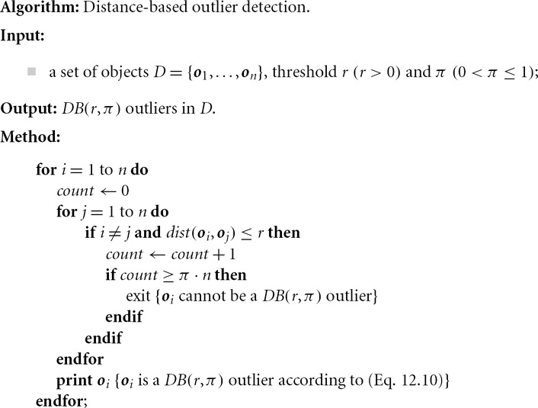
Distance-Based Outlier Detection
18

Slide 19
Distance-Based Outlier Detection: Improving Algorithm
Why efficiency is still a concern? When the complete set of objects cannot be held into main memory, cost of I/O swapping will be high
The major cost:
(1) each object tests against the whole data set, why not only its close neighbor?
(2) instead of checking objects one by one, why not group by group?
Grid-based method (CELL): Data space is partitioned into a multi-D grid. Only adjoining cells are checked for determining if object is an outlier
19

Slide 20
K nearest neighbour method
Consider the data matrix given below .Assume that outlier score of object is given by average of distances to the first k nearest neighbours .Determine the outlier for the given dataset with 2 nearest neighbour approach
 | A | B | C | D | E
A | 0 | 1 | 4 | 5 | 7
B | 1 | 0 | 2 | 6 | 8
C | 4 | 2 | 0 | 3 | 4
D | 5 | 6 | 3 | 0 | 4
E | 7 | 8 | 4 | 4 | 0
K=2
OS(P)=dist(p,x1)+dist(p,x2)………+dist(p,xn)/k
OS(A)=1+4/2=5/2=2.5
OS(B)=1+2/2=1.5
OS(C)=2+3/2=2.5
OS(D)=3+4/2=3.5
OS(E)=4+4/2=4
Outlier is E

Slide 21
Distance-Based Outlier Detection: Limitations
Distance-based outlier detection takes a global view of the data set
To detect distance-based outliers, we need two global parameters, r and π, which are applied to every outlier object.
Many real-world data sets demonstrate a more complex structure, where objects may be considered outliers with respect to their local neighborhoods, rather than with respect to the global data distribution.

Slide 22
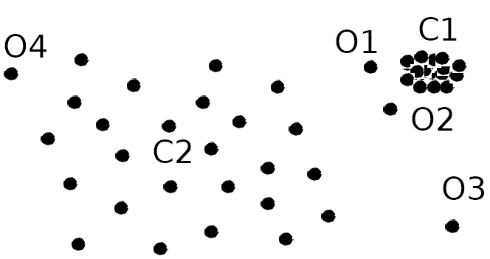
Density-Based Outlier Detection
Intuition (density-based outlier detection): The density around an outlier object is significantly different from the density around its neighbors
Method: Use the relative density of an object against its neighbors as the indicator of the degree of the object being outliers
Local outliers: Outliers comparing to their local neighborhoods, instead of the global data distribution
22

Slide 23
Local Reachability Density
Reachability distance from o’ to o:
where k is a user-specified parameter
that controls the smoothing effect
Local reachability density of o:
23

Slide 24

Local Outlier Factor: LOF
LOF (Local outlier factor) of an object o is the average of the ratio of local reachability of o and those of o’s k-nearest neighbors
The lower the local reachability density of o, and the higher the local reachability density of the k-NN of o, the higher LOF
This captures a local outlier whose local density is relatively low comparing to the local densities of its k-NN
24

Slide 25
LocalOutlier Factor Calculation in 6 Steps
Distance Calculation
Local Reachability Density (LRD) Calculation
Kth-Nearest Neighbor Distance Calculation
K-Nearest Neighbor Calculation
Local Outlier Factor Calculation Analysis

Slide 26
Example
Consider the following 4 data points: a(0, 0), b(0, 1), c(1, 1), d(3, 0) Calculate the LOF for each point and show the top 1 outlier, set k = 2 and use Manhattan Distance.
Step 1: calculate all the distances between each two data points
• There are 4 data points: a(0, 0), b(0, 1), c(1, 1), d(3, 0) (Manhattan Distance here)
dist(a, b) = 1
dist(a, c) = 2
dist(a, d) = 3
dist(b, c) = 1
dist(b, d) = 3+1=4
dist(c, d) = 2+1=3

Slide 27
Step 2: calculate all the dist2 (o)
• distk (o): distance between o and its k-th NN( k-th nearest neighbour)
dist2 (a) = dist(a, c) = 2 (c is the 2nd nearest neighbor)
dist2 (b) = dist(b, a) = 1 (a/c is the 2nd nearest neighbor)
dist2 (c) = dist(c, a) = 2 (a is the 2nd nearest neighbor)
dist2 (d) = dist(d, a) = 3 (a/c is the 2nd nearest neighbor)

Slide 28
Step 3: calculate all the Nk (o)
■ k-distance neighbourhood of o, Nk
(o) = {o’| o’ in D, dist(o, o’) ≤ distk (o)}
N2 (a) = {b, c}
N2 (b) = {a, c}
N2 (c) = {b, a}
N2 (d) = {a, c}

Slide 29
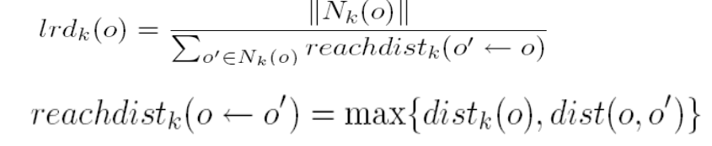
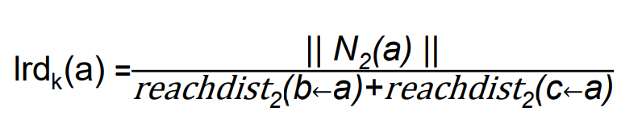
Step 4: calculate all the lrdk (o)
lrdk (o): Local Reachability Density of o || Nk (o) || means the number of objects in Nk (o),
For example: || N2 (a) || = || {b, c} || = 2

Slide 30
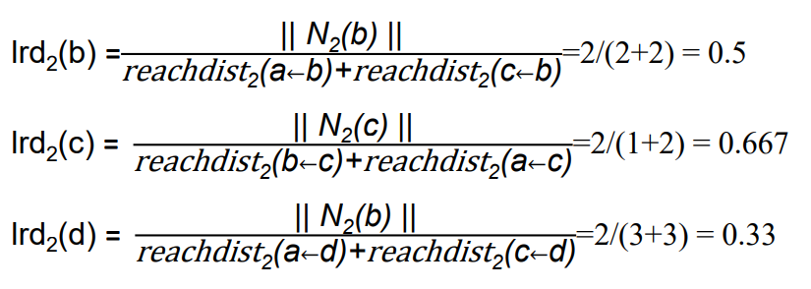
Step 4: calculate all the lrdk (o)
reachdist2 (b ← a) = max{dist2 (b), dist(b, a)} = max{1, 1} = 1
reachdist2 (c ← a) = max{dist2 (c), dist(c, a)} = max{2, 2} = 2
Thus, lrd2 (a) = || N2 (a) || / reachdist2 (b←a)+reachdist2 (c←a)=2/(1+2) = 0.667

Slide 31
kNearestSet(a) = { b, c }
kNearestSetCount(a) = 2
LOF(a) = [LRD(b) + LRD(c)] * [reachDist(b <- a) + reachDist(c <- a)] / kNearestSetCount(a)*kNearestSetCount(a)
LOF(a) = [.5 + .667] * [1 + 2] / (2 * 2)
LOF(a) = 3.501 / 4
LOF(a) = .87
LOF(b) = [LRD(a) + LRD(c)] * [reachDist(a <- b) + reachDist(c <- b)] / kNearestSetCount(b)*kNearestSetCount(b)
LOF(b) = 1.33
LOF(c) = [LRD(b) + LRD(a)] * [reachDist(a <- c) + reachDist(b <- c)] / kNearestSetCount(c)*kNearestSetCount(c)
LOF(c) = .87
LOF(d) =[LRD(a) + LRD(c)] * [reachDist(a <- d) + reachDist(c <- d)] / kNearestSetCount(d)*kNearestSetCount(d)
LOF(d) = 2

Slide 32
LOF(a) = .87
LOF(b) = 1.33
LOF(c) = .87
LOF(d) = 2
top 2 outliers from set are b and d.

Slide 33
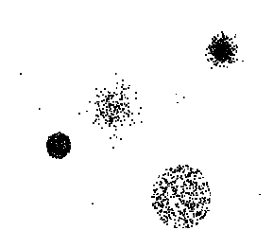
Clustering-Based
Basic idea:
Cluster the data into groups of different density
Choose points in small cluster as candidate outliers
Compute the distance between candidate points and non-candidate clusters.
If candidate points are far from all other non-candidate points, they are outliers

Slide 34


Base Rate Fallacy
Bayes theorem:
More generally:

Slide 35
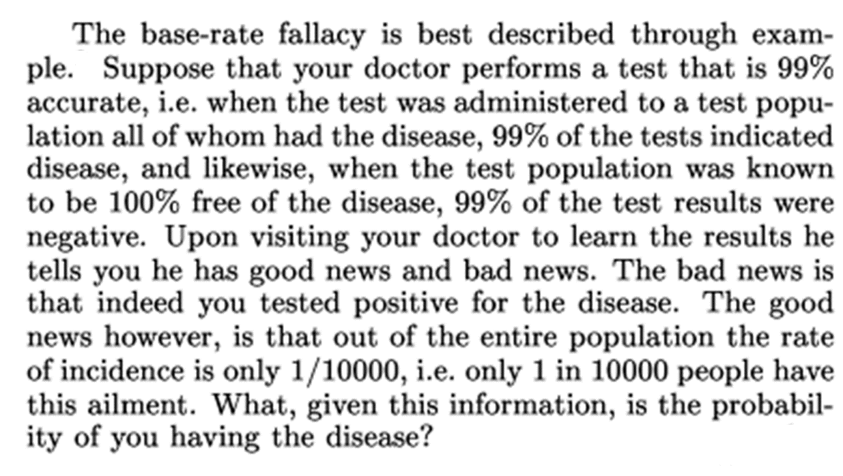
Base Rate Fallacy (Axelsson, 1999)

Slide 36


Base Rate Fallacy
Even though the test is 99% certain, your chance of having the disease is 1/100, because the population of healthy people is much larger than sick people

Slide 37
Prescribed Text Books
 | Author(s), Title, Edition, Publishing House
T1 | Tan P. N., Steinbach M & Kumar V. “Introduction to Data Mining” Pearson Education
T2 | Data Mining: Concepts and Techniques, Third Edition by Jiawei Han, Micheline Kamber and Jian Pei Morgan Kaufmann Publishers
R1 | Predictive Analytics and Data Mining: Concepts and Practice with RapidMiner by Vijay Kotu and Bala Deshpande Morgan Kaufmann Publishers

